Slide 1

JUnit Framework
Version: 1.0
Author:
Date of training course (automatically update
Sunday, November 8, 2026
Instructor:

Slide 2
Introduction
Duration: 2 hours
Purpose: introduce about unit testing and JUnit
Audience: developers
Test: Practice test

Slide 3

Objectives
After the course, student will:
Understand Unit testing and Junit
Know how to write a JUnit test class
Know how to install JUnit and run a JUnit test case
Know about some tips of Unit testing

Slide 4
Agenda
  Introduction
  What is JUnit?
  Setting up JUnit
  Exploring JUnit
  Samples
  Calculate Code coverage
  Tips
  Notice: This training is for JUnit 3

Slide 5
Introduction
  You know
    Every programmer knows they should write tests for their code.
  But
    The universal response to "Why not?" is "I'm in too much of a hurry."
  JUnit comes as a solution for this situation ……..

Slide 6
What is JUnit?
  JUnit is de facto Java unit testing framework
  Integrated nicely with many IDEs, Ant
  Easy to use and to learn

Slide 7
Agenda
  Introduction
  What is JUnit?
  Setting up JUnit
  Exploring JUnit
  Samples
  Calculate Code coverage
  Tips

Slide 8
Setting up JUnit
  Download JUnit from http://junit.org/
  Installation
    Unzip the junit.zip file
    Add junit.jar to the CLASSPATH.
  Testing
  Test the installation by using either the batch or the graphical TestRunner tool to run the tests that come with this release.
  All the tests should pass OK.
  Notice:
    The tests are not contained in the junit.jar but in the installation directory directly. Therefore make sure that the installation directory is on the class path

Slide 9
Setting up JUnit (cont)
  Testing
    for the console TestRunner type:
    java junit.textui.TestRunner junit.samples.AllTests
    for the graphical TestRunner type:
    java junit.awtui.TestRunner junit.samples.AllTests
    for the Swing based graphical TestRunner type:
    java junit.swingui.TestRunner junit.samples.AllTests

Slide 10
Agenda
  Introduction
  What is JUnit?
  Setting up JUnit
  Exploring JUnit
  Samples
  Calculate Code coverage
  Tips

Slide 11
Exploring JUnit
TestSuite
Test runner
Result
TestCase
When you want to write JUnit test for a class, you need to implement a TestCase object
A test (Java method) tests a single method of the class
  You can have multiple test for a single method
The test fixture provides the set of common resources or data that you need to run one or more tests.
When you need to run several TestCase objects at once, you create another object called a TestSuite
The test runner runs tests or an entire test suite
Test
Test
Test Fixture
TestCase
Test
Test
Test Fixture
TestCase (Java class)
Test (Java method)
Test (Java method)
Test Fixture
Notes:
- When you write JUnit test, most often you write TestCases and Tests

Slide 12
Implementing a Test Case class
  Extend junit.framework.TestCase class
  Inherit the following methods:
    protected void setUp()
    - Typically, you will override this method and use it to initialize the test fixture you need in testing
    protected void tearDown()
    - You will override this method to release or destroy test fixtures if need
  Write any number of test (test methods), all of which have the form public void testXXX()
  Define a main() method that runs the TestCase class
  A typical TestCase includes two major components:
      the fixture
      the tests
Notes:
- The framework ships with ready-to-use graphical and textual TestRunners. The
framework can also generate a default runtime TestSuite for you. So, the only
class you absolutely must provide yourself is the TestCase.

Slide 13

Test Fixture
  The set of background resources that you need to run a test is commonly called a test fixture. Eg: database connection, file, test data…
  A fixture is automatically created and destroyed by a TestCase through its setUp and tearDown methods.
  Order when run a test method
Notes:
- A database connection is a good example of why you might need a fixture. If a
TestCase includes several database tests, they each need a fresh connection to the
database. A fixture makes it easy for you to open a new connection for each test
without replicating code.
-

Slide 14
Creating a Test
  Your test method should start with public void testSomething(), where Something is any name you like (typically the name of the method you are testing)
  Fundamental steps to write a Test:
    Initiate necessary fixtures
    Call the method being tested and get the actual result
    Assert what the correct result should be with one of the assert methods of JUnit frame work
    These steps can be repeated as many times as necessary
Notes:
- The framework ships with ready-to-use graphical and textual TestRunners. The
framework can also generate a default runtime TestSuite for you. So, the only
class you absolutely must provide yourself is the TestCase. A typical TestCase
includes two major components: the fixture and the unit tests.
- You do not need to call these methods, they will be called automatically
- You do not need to do anything if the tests fail; the framework will take care of this for you

Slide 15
Assert methods
  An assert method is a JUnit method that performs a test, and throws an AssertionFailedError if the test fails.
  There are 8 core assert methods:
    assertTrue: Asserts that a condition is true
    assertFalse: Asserts that a condition is true.
    assertEquals: Asserts that two objects are equal.
    assertNotNull: Asserts that an object isn’t null.
    assertNull: Asserts that an object is null.
    assertSame: Asserts that two objects refer to the same object.
    assertNotSame: Asserts that two objects do not refer to the same object.
    fail: Fails a test immediately with the given message.

Slide 16
The Counter class
public class Counter {
int count = 0;
public int increment() {
return ++count;
}
public int decrement() {
return --count;
}
public int getCount() {
return count;
}
}
The constructor will create a counter and set it to zero
The increment method will add one to the counter and return the new value
The decrement method will subtract one from the counter and return the new value

Slide 17
JUnit test for Counter
public class CounterTest extends junit.framework.TestCase {
Counter counter;
public CounterTest() { } // default constructor
protected void setUp() { // creates a (simple) test fixture
counter = new Counter();
}
protected void tearDown() { } // no resources to release
public void testIncrement() {
assertTrue(counter.increment() == 1);
assertTrue(counter.increment() == 2);
}
public void testDecrement() {
assertEqual(counter.decrement(), -1);
}
public static void main(String[] args) {
junit.textui.TestRunner.run(CounterTest .class);
}
}
Note that each test begins with a brand new counter
This means you don’t have to worry about the order in which the tests are run

Slide 18
Creating a TestSuite
  Create a class and implement suite() method to create TestSuite and add TestCase classes to TestSuite
  public static Test suite() {
  TestSuite suite = new TestSuite(“test”);
  suite.addTest(Counter.class);
  suite.addTest(Caculator.class);
  return suite;
  }
  Define a main() method that runs the TestSuite
  public static void main (String [] args) {
  junit.textui.TestRunner.run(suite());
  //junit.swingui.TestRunner.run(suite());
  }

Slide 19
Test Runner
  The JUnit distribution includes three TestRunner classes:
    For the text console: junit.textui.TestRunner
    For Swing: junit.swingui.TestRunner
    for AWT: junit.awtui.TestRunner
  Run a TestSuite or a TestCase
    java junit.textui.TestRunner suite class/testcase class
    java junit.swingui.TestRunner suiteclass/testcase class
    Java junit.awtui.TestRunner suiteclass/testcase class
  Many IDEs support their own TestRunner to run: Eclipse, JDeveloper…

Slide 20
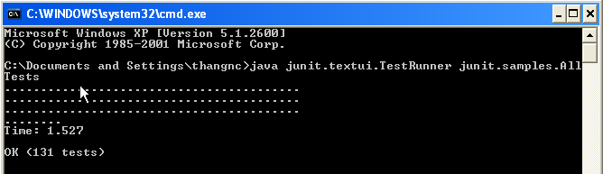
Test Runner (cont)
  Text console

Slide 21
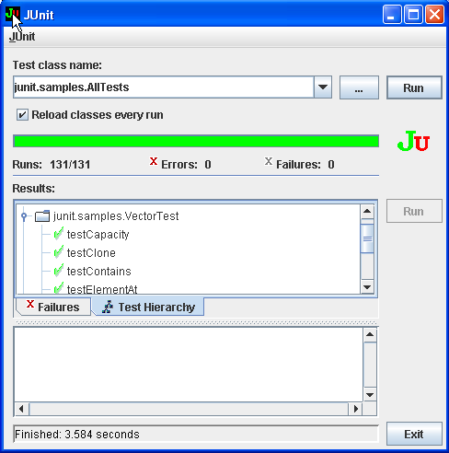
Test Runner (cont)
  Swing

Slide 22
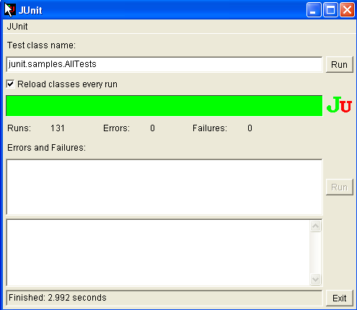
Test Runner (cont)
  Awt

Slide 23
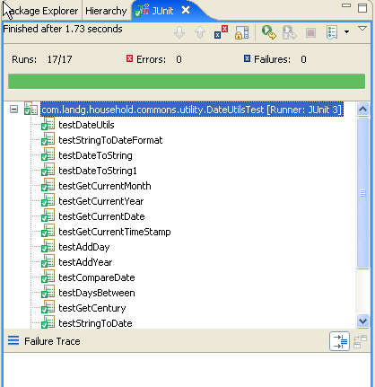
Test Runner (cont)
  Eclipse

Slide 24
Test Result
  A test method in a test case can have one of three results:
    Pass – all assertions matched expected values
    Failed – an assertion did not match expected value
    Error – an unexpected exception was thrown during execution of test method

Slide 25
Agenda
  Introduction
  What is JUnit?
  Setting up JUnit
  Exploring JUnit
  Samples
  Calculate Code coverage
  Tips

Slide 26
Agenda
  Introduction
  What is JUnit?
  Setting up JUnit
  Exploring JUnit
  Samples
  Calculate Code Coverage
  Tips

Slide 27
Code coverage
  Good unit tests are thorough; they test everything that's likely to break. You can aim to test every line of code, every possible branch the code might take, every exception it throws, and so on
  Use code coverage tools to determine how much of the code under test is actually being exercised (Clover, Cobertura, EMMA …)

Slide 28
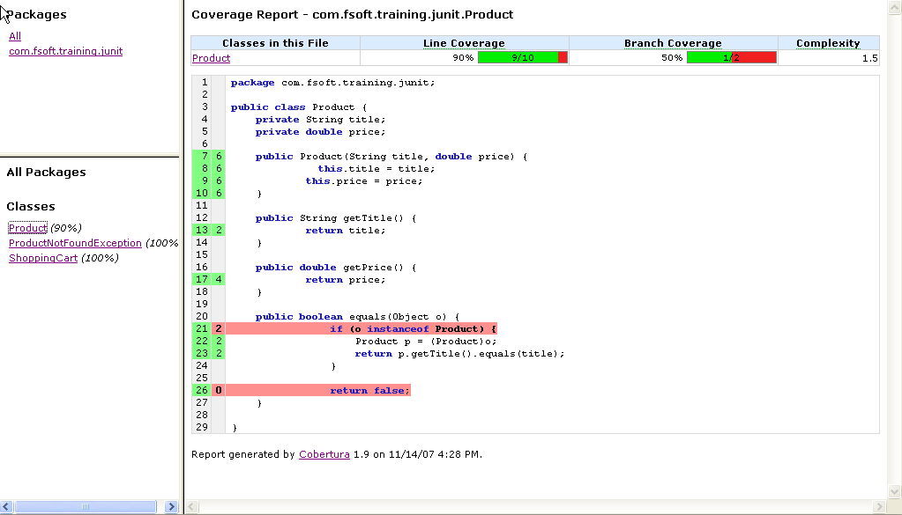
Cobertura tool

Slide 29
Cobertura tool
  What is Cobertura?
    free Java tool that calculates the percentage of code accessed by tests.
    used to identify which parts of your Java program are lacking test coverage.
  Features
    Can be executed from ant or from the command line.
    Instruments Java bytecode after it has been compiled.
    Can generate reports in HTML or XML.
    Shows the percentage of lines and branches covered for each class, each package, and for the verall project.
    Can sort HTML results in ascending or descending order by
      class name
      percent of lines covered
      percent of branches covered
  Download at : http://cobertura.sourceforge.net/

Slide 30
Cobertura tool
  How to setup ?
    Setting value for system values
      JAVA_HOME
      ANT_HOME
      Include ANT_HOME/bin and JAVA_HOME/bin to PATH variable
      Point CLASSPATH to necessary Jar, zip files
    Create build properties file – Configure report structure
    Create Ant build file – build.xml file
  Demo Shopping Cart sample
Demo

Slide 31
Agenda
  Introduction
  What is JUnit?
  Setting up JUnit
  Exploring JUnit
  Samples
  Calculate Code coverage
  Tips

Slide 32
Tips (Best practices)
  Do not use the test-case constructor to set up a test case
  Don't assume the order in which tests within a test case run
  Call a superclass's setUp() and tearDown() methods when subclassing
  Utilize JUnit's assert/fail methods and exception handling for clean test code
  Keep tests small and fast
  Do not load data from hard-coded locations on a filesystem
  Name tests properly
  For each Java package in your application, define a TestSuite class that contains all the tests for validating the code in the package.
  Define similar TestSuite classes that create higher-level and lower-level test suites in the other packages (and sub-packages) of the application.
  Make sure your build process includes the compilation of all tests.

Slide 33
Mock Object
  Unit-testing each method in isolation from the other methods or the environment is certainly a nice goal. But how do you perform this feat?
  The answer is called mock objects.
  A mock object (or mock for short) is an object created to stand in for an object that your code will be collaborating with. Your code can call methods on the mock object, which will deliver results as set up by your tests.
  Some mock object frame works:
    EasyMock: www.easymock.org/
    jMock: www.jmock.org
    Mocquer: mocquer.dev.java.net/

Slide 34
JUnit extensions
  There are many JUnit extensions supporting for implementing JUnit test:
    DBUnit to test database
    HttpUnit, JWebUnit, Canoo WebTest to test interface
    XMLUnit to test XML
    StrutsTestCase to test Struts
    …

Slide 35
CONCLUSION
JUnit is de facto Java unit testing framework
Use TestRunner, Ant or IDEs to run test cases
Extend junit.framework.TestCase class
setUp() method is used to initialize test case
tearDown() is used to release or destroy
Use TestRunner or IDEs to run your test cases
There are many JUnit extensions such as DBUnit, HttpUnit, StrutsTestCase ...

Slide 36

Q&A

